Slide 1
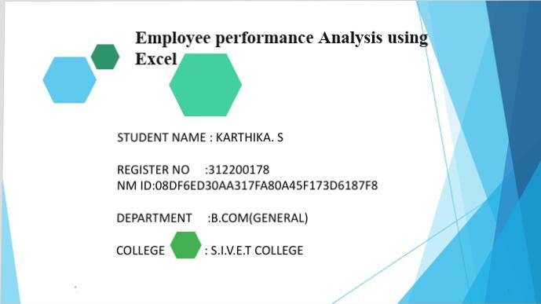
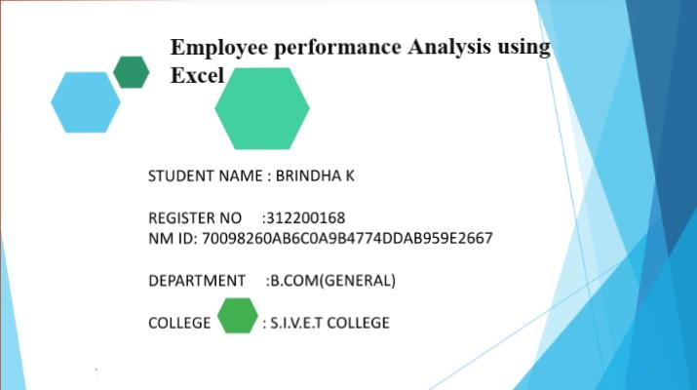
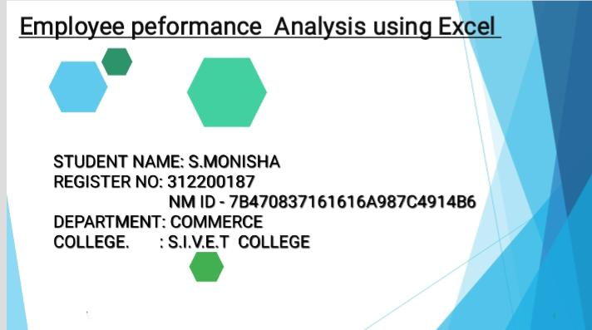
STUDENT NAME:K.MAHESH KUMAR
REGISTRATION NO: 312207161
NM ID : FF5CB85E2DB26A8903D4F89C210600B4
Department: B.COM (MARKETING MANAGEMENT)
COLLEGE: A.M JAIN COLLEGE

Slide 2


Slide 3


Slide 4
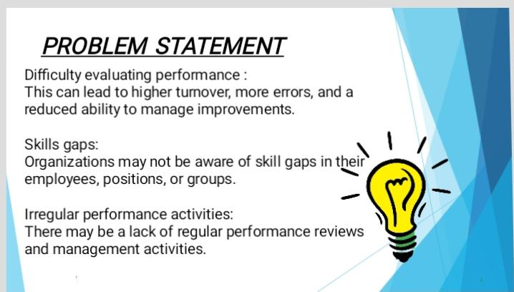

Slide 5


Slide 6


Slide 7


Slide 8
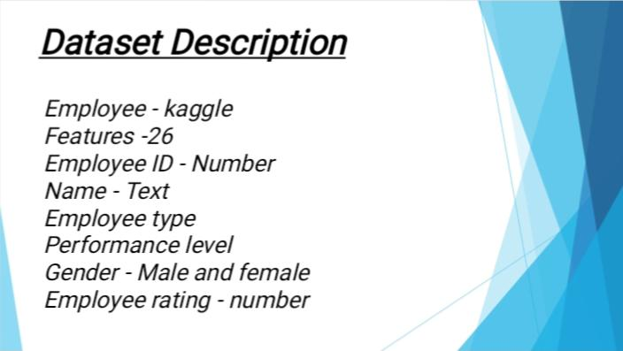

Slide 9


Slide 10
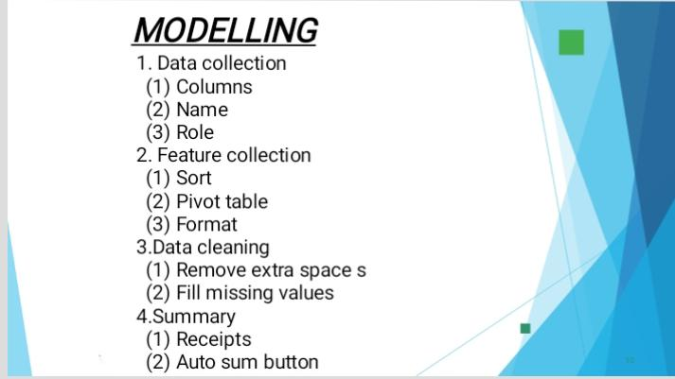

Slide 11
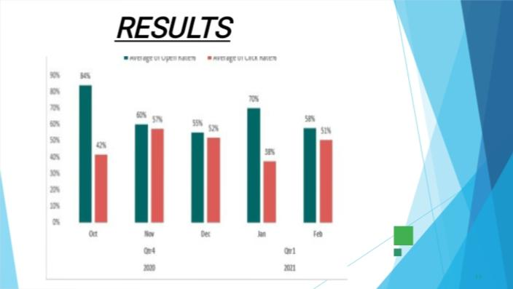

Slide 12
